Slide 1


The JavaScript Language
An Introduction
DÁVID BURAI
based on Attila Gyöngyösi’s slides
MARCH 12, 2020

Slide 2
DÁVID BURAI
MARCH 12, 2020

Slide 3

ABOUT ME
David Burai
Mentee in 2017
UI developer at EPAM since 2018

Slide 4

AGENDA
What is JavaScript?
Identifiers & Control Flow
Error handling
Data Types & Literals
Operations
Scopes
Functions
Callbacks & IIFEs
JSON
Timers
Exercises!

Slide 5

JavaScript – An Introduction
What is
Javascript?

Slide 6

WHAT IS JAVASCRIPT?
A high-level, interpreted programming/scripting language
NOT Java(!)
Prototype-based
Loosely / dynamically typed
Synchronous
Originally designed for browser, but now used literally everywhere
ECMAScript Current version is ES10
Notes:
ES6 classes are syntatic sugar for prototypes

Slide 7









LITERALLY EVERYWHERE
Notes:
ES6 classes are syntatic sugar for prototypes

Slide 8
JavaScript – An Introduction
IDENTIFIERS
& control flow

Slide 9
VARIABLES & CONTROL FLOW
IDENTIFIERS
The name of variables, functions and keywords
Must start with a letter, underscore (_) or dollar sign ($)
Can be followed by numbers, letters, underscores and dollar signs
Are case sensitive awYeah != awYEAH
Convention: camelCase var funTime = true;

Slide 10
VARIABLES & CONTROL FLOW
IDENTIFIERS
Declaring variables
var keyword (old)
Block scoped keywords
let:
Initialization is not required
Can be reassigned
const:
Must be initialized
Cannot be reassigned
Uninitialized variable value: undefined

Slide 11
IDENTIFIERS & CONTROL FLOW
CONTROL FLOW
Control flow statements are similar to other high-level languages
Branching
if / else if / else
switch / case
Loops
for
while
do .. while
for .. in (ES6)
for .. of (ES6)
Notes:
Else if different color, because it might be different from other languages

Slide 12
JavaScript – An Introduction
ERROR HANDLING

Slide 13
ERROR HANDLING
CONTROL FLOW
Best way to handle errors is to write good code
try-catch statement
try {
doSomething();
} catch (err) {
throw new Error(’Oops');
} finally {
iDontCareWhatHappenedIWillRun();
}
It ensures that rest of the code continues to execute.
Notes:
Else if different color, because it might be different from other languages

Slide 14
JavaScript – An Introduction
DATA TYPES & LITERALS

Slide 15
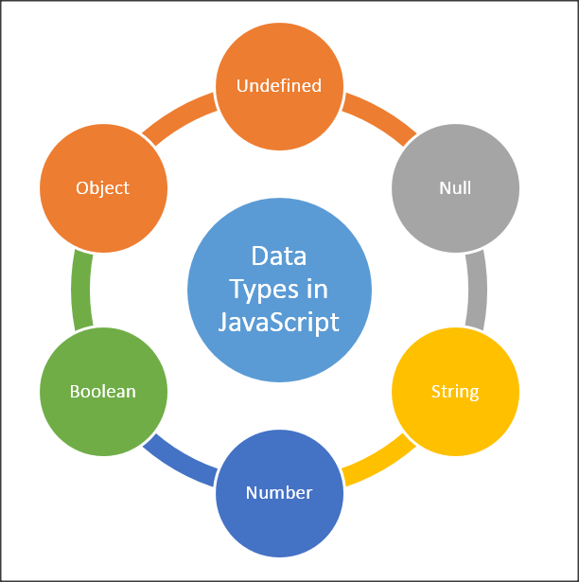
DATA TYPES & LITERALS
PRIMITIVE TYPES
null Has only one value: null
undefined New variables that haven’t been assigned a value
Boolean Logical value; true or false
Number 12, 42.01
String ”JavaScript is love, JavaScript is life”
Symbol (ES6)
Unique and immutable primitive value

Slide 16
DATA TYPES & LITERALS
COMPLEX TYPES
Object A collection of properties (key-value pairs)
Note: In fact, almost everything is an object { id: 1, howMuchIsTheFish: ”nana-nananana”, isButAScratch: true, innerObject: { x: [1, ’x’] } }

Slide 17
DATA TYPES & LITERALS
LITERALS
Literals are fixed values within the code.
Integer literals
Decimal 12
Leading 0 / 0o / 0O: octal 007
Leading 0x / 0X: Hexadecimal 0xAF1
Leading 0b / 0B: Binary 0b001001
Notes:
All numbers are internally floating point

Slide 18
DATA TYPES & LITERALS
LITERALS
Floating-point literals [(+|-)][digits][.digits][(E|e)[(+|-)]digits]
Decimal integer
Floating point (.)
Fraction (decimal)
Exponent (decimal)
Boolean literals: true and false
String literals Zero or more characters enclosed in ’’ , ”” or `` ’I am a string literal, yo’ ”Me too, buddy” `I am a string you will like!`
Notes:
ES6 Template / multiline string, can be multiline, can insert variable with ${variable}

Slide 19
DATA TYPES & LITERALS
LITERALS
Object literals Zero or more property names with their associated values, separated by commas, enclosed in { and }
var o = {
isLiteral: true,
talkAboutFightClub: false
}
o.isLiteral // true
o[’talkAboutFightClub’] // false

Slide 20
DATA TYPES & LITERALS
LITERALS
Array literals Zero or more expressions enclosed in [ and ]
var a = [’Funk’, 12, true, {x: 11.0}];
a[1] // 12
Arrays are objects internally
a = {
0: ’Funk’,
1: 12,
3: true,
4: {x: 11.0}
}

Slide 21
DATA TYPES & LITERALS
IMMUTABILITY
Primitives are immutable
var statement = "I am an immutable value";
var otherStr = statement.slice(8, 17);
statement // "I am an immutable value";
otherStr // ”immutable”
Only non-primitives are mutable
var arr = [1, 2, 3, 4];
var v2 = arr.push(5);
arr // [1, 2, 3, 4, 5]
v2 // 5
Comparing by value / by reference
Primitives: by value
Non-primitives: by reference

Slide 22
JavaScript – An Introduction
OPERATIONS

Slide 23
OPERATIONS
OPERATING ON STRINGS
.length returns the length of the String. ’bird’.length; // 4
.split() splits the string into an array by the given separator ’apple’.split(); // [’a’, ’p’, ’p’, ’l’, ’e’] ’house cat’.split(’ ’) // [’house’, ’cat’]
.concat() concatenates multiple strings into one ’one’.concat(’ two’, ’three’); // ’one twothree’
With plus sign
”I’m a concatenated ” + ”string.”
.indexOf() Returns the index of the first occurrence of the specified value or -1 if not found ’funeral’.indexOf(’fun’) // 0

Slide 24
OPERATIONS
OPERATING ON BOOLEANS
Negation: !
Truthy: evaluates to true
Falsy: evaluates to false
Falsy values:
false
0
””
null
undefined
NaN (Not a Number)
Convert truthy/falsy to true/false !!falsyValue // false

Slide 25
OPERATIONS
OTHER OPERATIONS
Equality == / != - compares value only (coercion) === / !== - compares value and type
typeof Returns the type of the given expression as a String typeof 1; // ”number” typeof(null); // ”object”
parseInt(string, base) Converts a string to an integer in a given base. Returns NaN if fails. parseInt(”5”, 10); // 5 parseInt(”bobby”, 2); // NaN

Slide 26
OPERATIONS
COERCION
The process of converting value from one type to another is being called coercion
Implicit coercion
values converted between different types automatically
1 + ”1” // ”11”
123 == ”123” // true
123 === ”123” // false
Explicit coercion
intention to convert between types
Number(”123”)
String(456)
Boolean([”0”, false])

Slide 27
JavaScript – An Introduction
scopes

Slide 28

SCOPES
Scope: a segment of code where a variable or a function is accessible
Unlike many other languages, JavaScript originally had no block scoping, only available from ES6
The var keyword
The let and const
Global scope vs. Function scope vs Block scope

Slide 29
SCOPES
GLOBAL SCOPE
A variable declared outside of a function or without the var keyword will be on the global scope
FUNCTION SCOPE
Variables declared inside functions will be on the function’s scope and only visible inside that function and in its nested functions.
BLOCK SCOPE
A variable declared with the let or const keyword will only be visible inside the block it was declared in, and it’s nested blocks

Slide 30
SCOPES
HOISTING
In JavaScript, a variable can be declared after it has been used x = 5; console.log(x); // 5 var x;
JavaScript has a default behavior to move every declaration to the top of the current scope. This is called hoisting. var x; x = 5; console.log(x); // 5

Slide 31
SCOPES
HOISTING
Source code | After hoisting
test(); // test1 test2(); // not a function! function test() { console.log('test1'); } var test2 = function() { console.log('test2'); }; | function test() { console.log('test1'); } var test2; test(); test2 = function() { console.log('test2'); };
Notes:
Variable hoisting gets ignored when there’s a function decalartion with the same name

Slide 32
JavaScript – An Introduction
FUNCTIONS

Slide 33
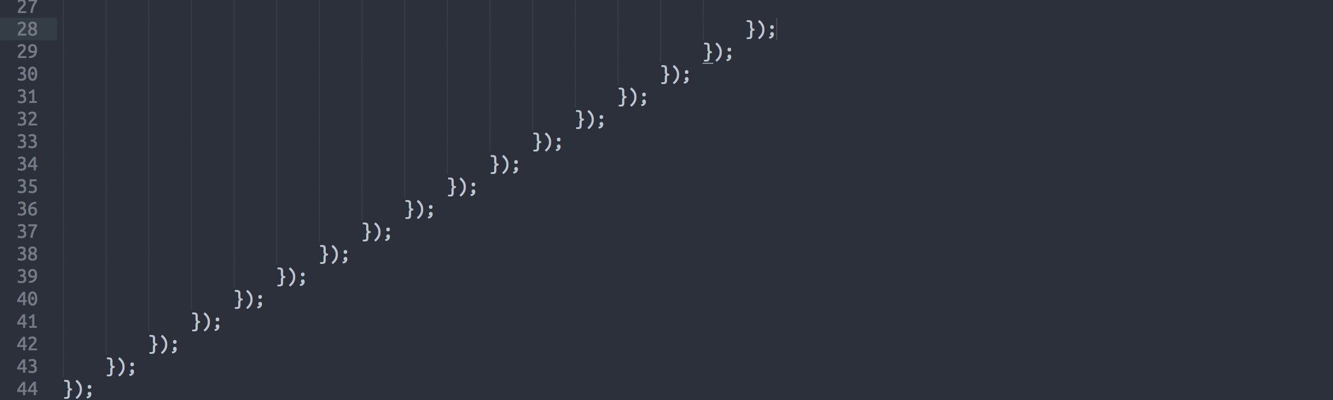
FUNCTIONS
One of the fundamental building blocks in JavaScript
A function is a procedure—a set of statements that performs a task or calculates a value
Functional programming (FP)

Slide 34
FUNCTIONS
In JavaScript, functions can be used in a very flexible way
First-class functions:
they do not have any special status and are treated just like variables
you can pass them as arguments to other functions
you can return them from other functions
can store them in variables and data structures

Slide 35
FUNCTIONS
Function declarations
They are hoisted with the definition
function square(number) {
return number * number;
};
Function expressions
Such functions can be anonymous
They are not hoisted
var square = function(number) {
return number * number;
};
Arrow functions
var square = (number) => {
return number * number;
};

Slide 36
FUNCTIONS
Nested functions
Function inside function..
Each function creates its own scope and has access to its outer scope
Parameters
arguments array-like object
Default parameters (ES6)

Slide 37
JavaScript – An Introduction
callbacks & IIFEs

Slide 38
CALLBACKS & IIFEs
CALLBACKS
Callbacks are essentially function arguments passed to another function, to be called at some point.

Slide 39
CALLBACKS & IIFEs
CALLBACKS
Callbacks are essentially function arguments passed to another function, to be called at some point. funkyTown(true, groove); function funkyTown(isFunk, cb) { console.log(’Funk? ’, isFunk); cb(’nananana’); } function groove(message) { console.log(message); }

Slide 40
CALLBACKS & IIFEs
IIFE
IIFE = Immediately Invoked Function Expression
A special construct and design pattern in JavaScript
Is a function that is called and executed immediately

Slide 41
CALLBACKS & IIFEs
IIFE
(function(x) { console.log(’x:’, x);
}(8)); // x: 8
var f = function(x) { console.log(’x:’, x);
}(’cat’); // x: ’cat’

Slide 42
CALLBACKS & IIFEs
IIFE
But why?
To not pollute global scope
To hide functions/variables while exposing others
To better separate code

Slide 43
JavaScript – An Introduction
timers

Slide 44


TIMERS
JavaScript execution in the browser is synchronous by default
There are ways to delay or schedule execution of code
Once, after an amount of time
Periodically

Slide 45
TIMERS
Once, after a given amount of time
window.setTimeout(function () {
console.log('Disco!');
}, 1000);
Periodically
window.setInterval(function () {
console.log('Party!');
}, 5000);

Slide 46
TIMERS
Stopping execution
var intvl = window.setInterval(function () {
console.log('Party!');
}, 5000);
window.clearInterval(intvl);
var timer = window.setTimeout(function () {
console.log(’Timeout!');
}, 1000);
window.clearTimeout(timer);

Slide 47
JavaScript – An Introduction
JSON

Slide 48

JSON
JSON = JavaScript Object Notation
A lightweight data interchange format
Readable to humans
Easily processed by programs
Like XML
A subset of JavaScript

Slide 49
JSON
MIME type is application/json
Can contain the following types:
Number
String
Boolean
Array
null
You can validate JSON against a schema (a special JSON)

Slide 50
JSON
{
”id”: 1,
”name”: ”Json Statham”,
”hasGun”: true, ”movies”: [
”Crank”,
”The Transporter”
]
}

Slide 51
JSON
Parsing JSON
eval() Risky! Could execute unwanted code!
JSON.parse() Since ES5. Parses a JSON string into an object. var d = '{"name": "John Doe", "age": 22 }'; var jsObject = JSON.parse(d); console.log(jsObject.name + ' ' + jsObject.age); // 'John Doe 22'

Slide 52
JavaScript – An Introduction
Exercises!

Slide 53
EXERCISES
Data Manipulation
Given the following variables:
var attrs = 'name age city gender';
var values = [
['Joe', 22, 'New York City', 'male'],
['Jane', 85, 'Las Vegas', 'female'],
['Jack', 55, 'London', 'male']
];
Build the following structure (not by hand): var people = [
{name: 'Joe', age: 22, city: 'New York City', gender: 'male'},
{name: 'Jane', age: 85, city: 'Las Vegas', gender: 'female'},
{name: 'Jack', age: 55, city: 'London', gender: 'male'},
];

Slide 54
EXERCISES
Sum of leaf nodes
Write a function which gets the root node of a binary search tree of numbers and returns the sum of all the leaf nodes.
Example input:
{
value: 5,
nodes: [
{
value: 6,
nodes: null
},
{
value: 7,
nodes: null
}
]
}
Example output: 13

Slide 55
EXERCISES
Sum of leaf nodes
Write a JavaScript program to construct the following pattern, which takes the number of levels as parameter
Function Input: 4
Example output:
* ** *** ****
Make it harder by accepting a 2nd parameter for the position of the asterisks (left, center or right)
* *** ***** *******

Slide 56
JavaScript – An Introduction
DOM events

Slide 57

DOM EVENTS
When interacting with web pages in a browser, various things can happen. These are called events and you can execute JavaScript code when events happen.
You can programatically react to browser events and create event-driven applications.

Slide 58
DOM EVENTS
COMMON EVENTS
onload fired by the browser when the HTML document finished loading
onclick an HTML element fires an onclick event when the user clicks on it

Slide 59
DOM EVENTS
COMMON EVENTS
onmouseover?
onmouseleave?
onkeydown?
onchange?

Slide 60
DOM EVENTS
COMMON EVENTS
onmouseover when user hovers over an element
onmouseleave when the pointer leaves the element
onkeydown when a key is pressed
onchange when a form input’s value changes

Slide 61
DOM EVENTS
EVENT HANDLING IN THE DOM
HTML: <nav onclick=”someJSFunction()”> </nav>
JS:
function someJSFunction() {
console.log(’Clicked nav, yo!’);
}

Slide 62
DOM EVENTS
’THIS’ OBJECT
this When given to a JavaScript event handler as a parameter, this represents the HTML element that fired the event

Slide 63
DOM EVENTS
’THIS’ OBJECT
HTML: <nav id=”someId” onclick=”someJSFunction(this)”> </nav>
JS:
function someJSFunction(this) {
console.log(this.getAttribute(’id’);
} // ’someId’

Slide 64
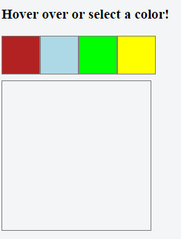
EXERCISES
Go to https://jsfiddle.net/
Create a simple web page like so ->
When user hovers over a colored box: Big box should change to that color
When user leaves a colored box: Big box should revert to its original color
When user clicks on a colored box: Big box’s color should be set to that color (and remain so)

